Slide 1
Water Utility Department
Howard Levison Water Utility Administrator
2022 Department Budget Presentation

Slide 2
2021 Budget – Background
A strategic capital improvement plan was developed to define critical points of failure and a mitigation plan to resolve noted deficiencies.
The process looked at system components from the top down identifying a number of critical major subsystems that provide the delivery and storage of water for domestic use and fire flow requirements from which both short and long term capital project areas were developed.
These project areas include a list of high priority short term (1-5 years) initiatives some of which are being worked on in terms of Planning, Design and Engineering and others are in various stages of implementation and completion.

Slide 3
2022 Budget – Continuation
Background:
The water system was neglected for 25 years under the management of East Orange Water Commission. Due to that neglect the system now requires not only remedial maintenance but significant investment in the infrastructure to assure high quality services including reliability and resiliency.
Critical to the operational integrity of the system a fault tree analysis had been performed with HDR Engineering developing a strategic long term infrastructure improvement and asset management plan. The objective was to perform an analysis of those critical assets and components and determine the impact of failures to those components to the integrity and reliability of the water system.
This review evolved into a series of multi-year capital initiatives begun in 2021 and now continuing into 2022 and beyond. In some cases the larger projects have been split out into shorter term manageable building blocks/segments some of which are being executed in parallel and reflected in the current capital budget.

Slide 4
2022 Short Term Capital Budget see attached spreadsheet

Slide 5
Crest Drive Standpipe:
The 1.5 MG Crest Drive welded steel standpipe was constructed in 1958. In July 2010, East Orange Water Commission (EOWC), the contract operator at the time for the South Orange water system, retained Utility Service Co., Inc. to conduct an ROV and visual inspection of the standpipe.
The findings from the inspection indicated the tank interior and exterior was in poor condition, corroded and contained interior and exterior lead concentrations from the lead-based primer coating. In addition, structural and foundation repairs are required. Several safety, sanitation and security deficiencies were also identified. It was also recommended to install a new active mixing system to assist in maintaining water quality, eliminate ice formation and prevent sediment from gathering on the tank floor.
The cumulative findings from the 2010 inspection, 2015 condition assessment and through discussions with South Orange, NJAW and NJDEP, it was recommended to replace the existing standpipe system entirely.
Current Status: Engineering & Design Phase: 90% complete
The Project has been broken down into multiple Phases to be bid separately this year:
Phased Implementation of the Replacement of the tank with Construction of a 1MG elevated tank on the current site and initially Interconnected with the current piping, placed in parallel operation, and then after acceptance the demolition of the old tank.
Installation of a new 16” supply main from the South Orange Ave. Reservoir Pump station to the new Crest Drive Storage Tank.
Upgraded pumps with VFD (Variable Frequency Drive) controllers.
Miscellaneous piping improvements/reconfiguration at Crest and Reservoir pump stations.
Installation of a replacement Generator on an external platform.
Funding for these projects are being applied for from the NJIB.

Slide 6
Critical Infrastructure Resiliency and Contingency Upgrades – Interconnects, Zone Valves, Valves, PRV’s (pressure relief valves), Redundant piping
This project represents mitigation of identified critical issues and implementation prioritization.
These include:
Backup supply Interconnect reconnections:
NJAW - Luddington
EOWC - South Orange Avenue
All of the following pending a detailed hydraulic analysis of various system states:
PRV’s (pressure relief valves - currently 6 between High & Low zones but are inoperative plus the potential of additional in key distribution locations) and/or Zonal Valves
Rail Road crossing mains (Montrose, Stewart, Mead, South Orange Ave, 3rd, DPW) of which two are in the roadbed without protective casings.
Main Improvements (West End) – note required to replace 2,500 linear feet per year -150 year rule (72 miles = 380,000’ / 150 yrs = 2,500 / yr).

Slide 7
Capital Improvements and Repair or Replacements (CI/RR) and Project Design and Engineering Services:
CI/RR:
The NJAW O&M monthly fee based contract covers a list of preventive maintenance responsibilities and emergent Capital Improvement (CI) / repair and replacement (RR) responsibilities based on a specified table of values. Experience has shown the funding for the CI/RR has tracked at $500k/year. Any annual surplus will be retained in a sinking fund account.
Project Design and Engineering Services:
As we move forward with initiation of planned water system development projects or in response to an emergent situations there is a need for funding of professional services to provide the detail design and specifications that lead to bid and contract award documents. A “Task Order” will be provided and a Resolution passed to support acceptance of the Task Order.
Depending on the specific project characteristics, funding for these projects will be applied for from the NJIB.
\

Slide 8
AMI (Advanced Metering Infrastructure) – NJIB
An assessment of current metering infrastructure at the Village concluded that the existing water meters were approaching their useful life with no method of periodic central monitoring.
After researching options and reviewing the current technologies, the Village decided to modernize its water metering system by implementing an Advanced Metering Infrastructure (AMI) system.
Successful implementation of the AMI system and a Data Management System (DMS), along with related process changes, helps to improve overall customer satisfaction and increased operational efficiency including reduction in loss revenue water.
Currently: (was Impacted by COVID-19):
An application has been made and approved by the NJIB/Clean Water SRF.
Fix antenna have been installed and are operational.
In process of a Cloud Software implementation (Neptune_360 ) with dynamic monitoring capability.
Preparing meter installation bid documents.
Preparing database maintenance Operating procedures.

Slide 9
Newstead/Brentwood Water Tank Rehabilitation - painting and piping upgrade:
This sphere is an elevated water storage tank constructed in the mid-1950s and is overdue for rehabilitation that includes repainting, piping modifications, and upgrading of the safety & security systems.
2022 Initiatives:
Investigating alternative piping configurations to enhance reliability that include:
Extending the main from end of Hoskier thru the Reservation border to an exterior chamber eliminating the vault under the Sphere. Then extending it to a high level in the Sphere providing proper mixing
Preparing painting bid documents.
Upgrading pumps with VFD controllers and metering.
Preparing specifications and requirements for taking the Sphere out of service while implementing these changes.

Slide 10
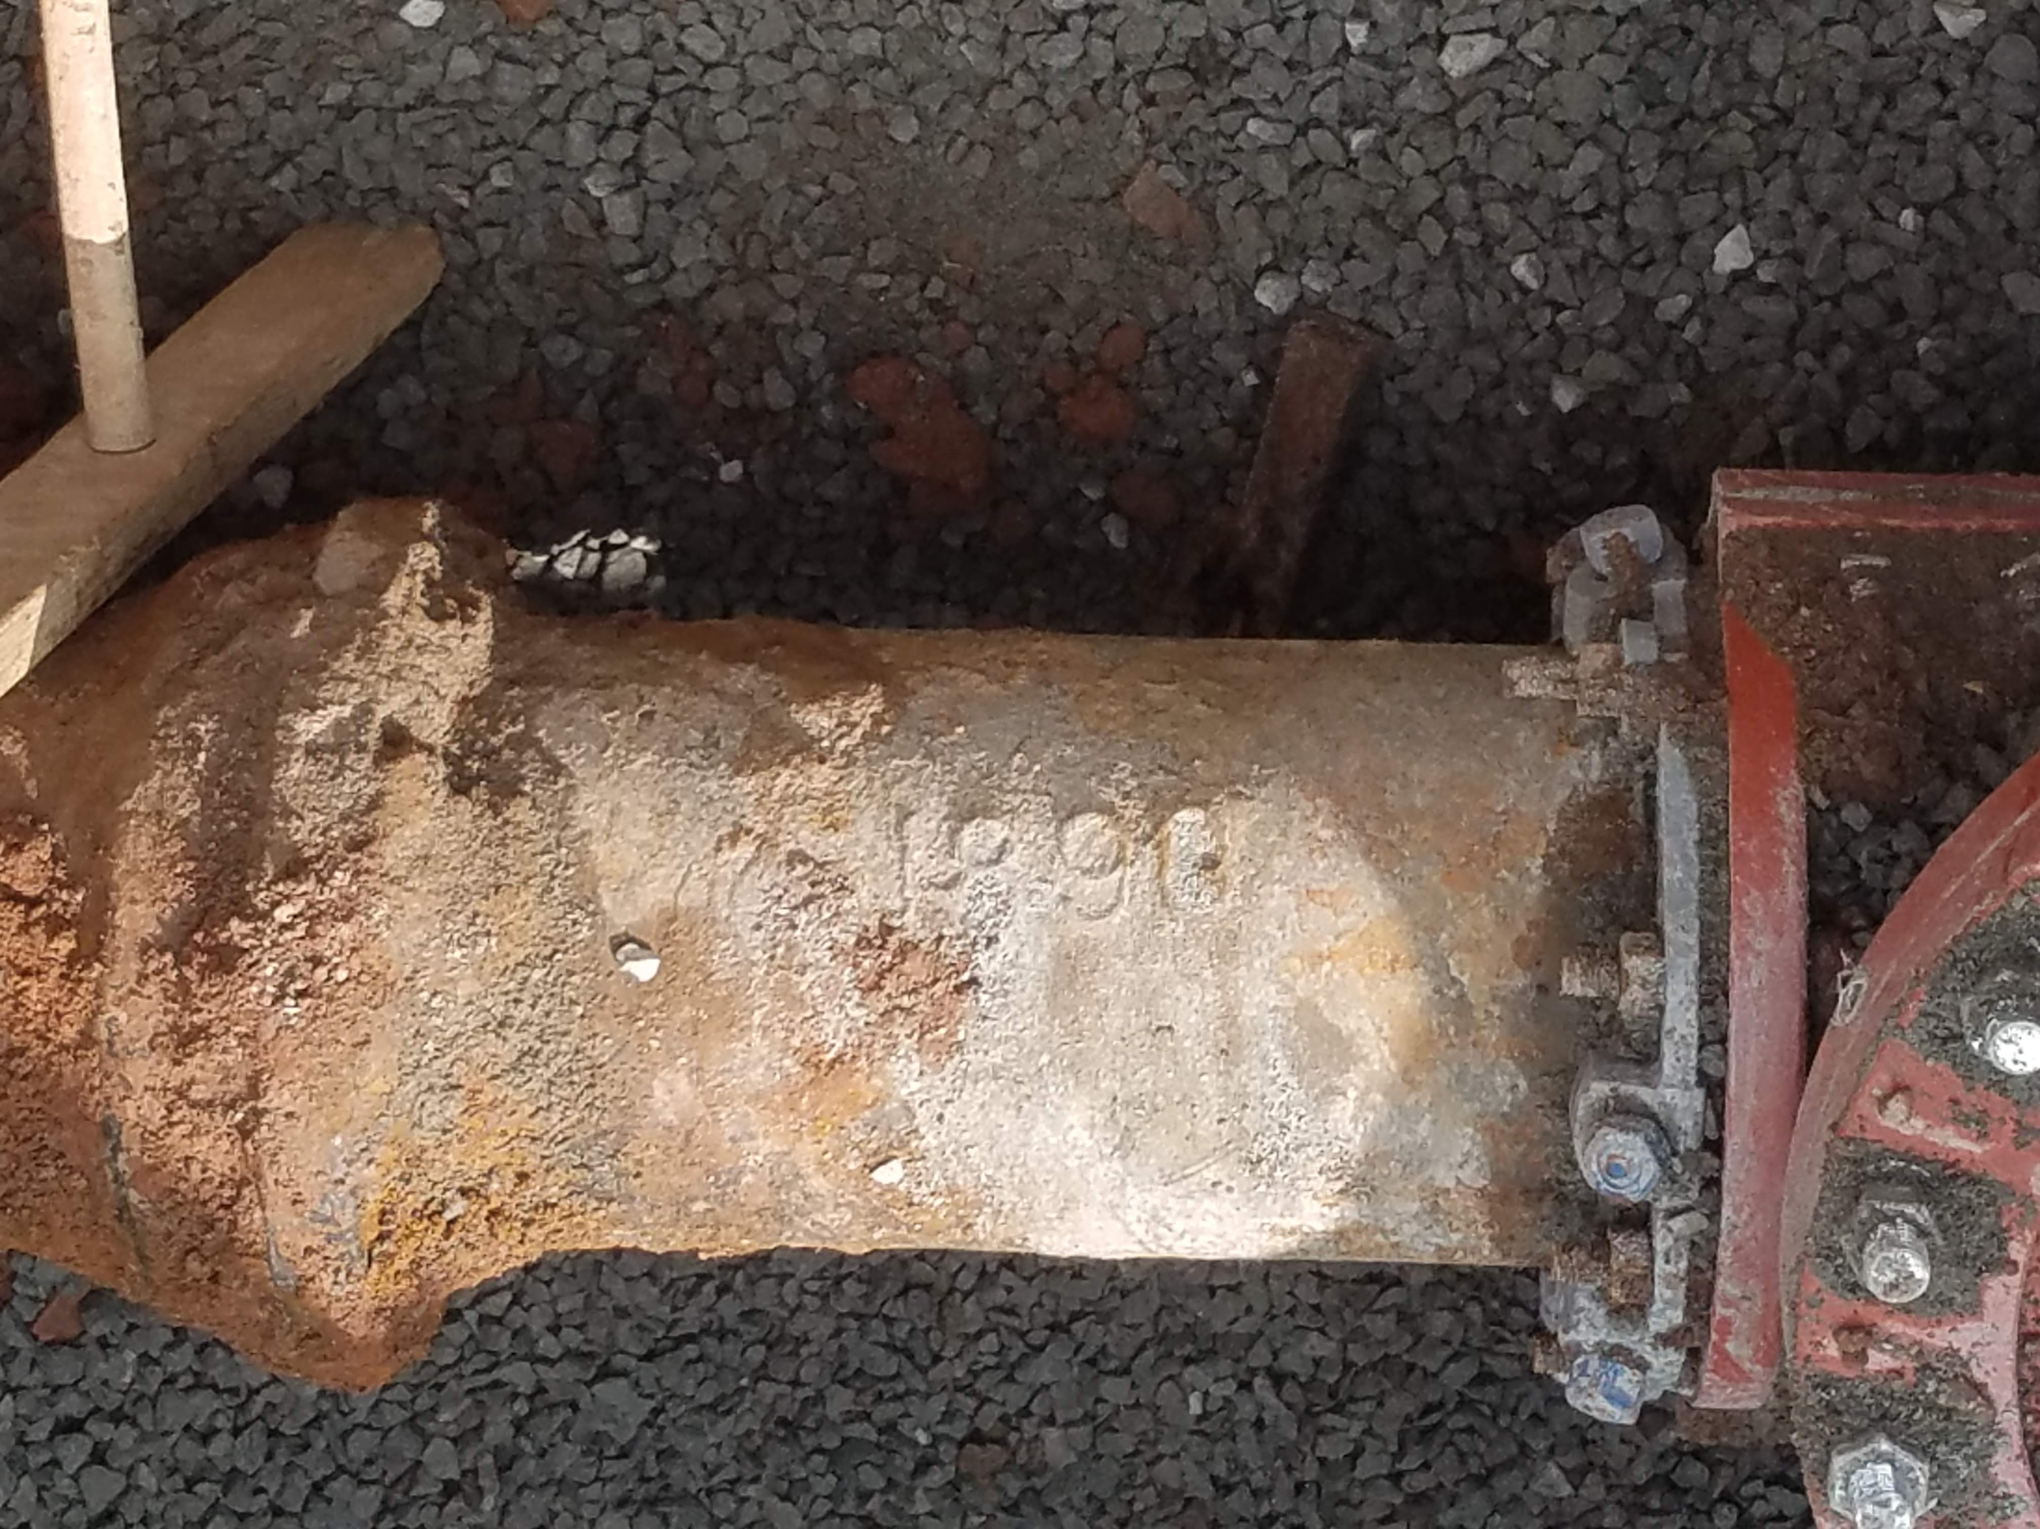
Well 17 Decommissioning and Other non-functioning/operational assets:
Officially (DEP) shut down these assets:
Well 17 has been decommissioned – 1/22
Ferrell Field - NJAW and EOWC Interconnects.
Based on a hydraulic system study develop decommissioning of prv’s and high risk Rail Road crossing mains – possible enhancement/supplement under trestle un-cased mains (Mead Street, Third Street, South Orange Avenue) to supplement possible loss of Stewart and Montrose.
- - - - - - - - - - - - - - - - -
Incorporate the installation of a Water Main as part of the West End Road (1902) reconstruction. This provides significant redundancy and resiliency to the eastern side of the Village – where most development is occurring. Pending results from a hydraulic review and physical road survey.
Also provides annual 150 year pipe replacement requirement.
Lead Pipe identification and replacement project - NEW

Slide 11
2022 operating budget see attached spreadsheet

