Slide 1

Village Spotlight Presentation

Slide 2
DOVE by the Numbers:
Weekly Programs 17-20 programs
Monthly / Special Programming (Fall 2023): 2,000 hours 500 students
Mission Trips 2 International / 4 Domestic
Fall 2023 5,625 hours 1,656 student commitments
Spring 2024 7,897.25 hours 1,609 student commitments
Total Academic Year 13,522.25 hours 2,725 students

Slide 3
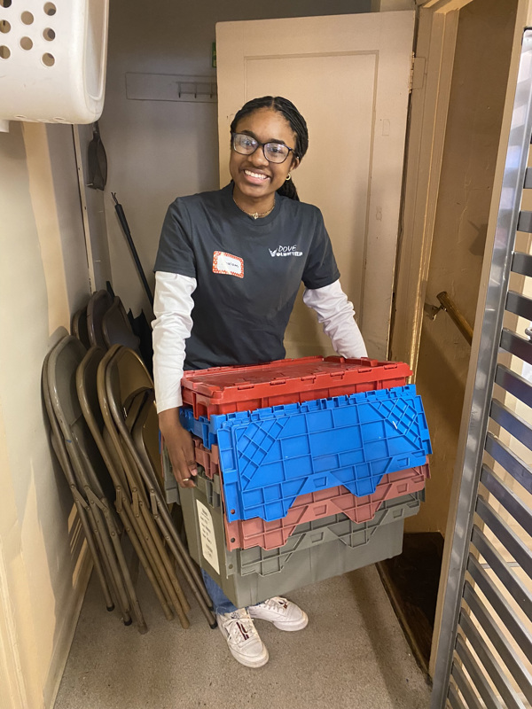
Food Insecurity Programming:
- St. John’s Soup Kitchen
- Interfaith Food Pantry of the Oranges
- Pierre Toussaint Food Pantry
- DOVE Mission Night
- Hillside Community FoodBank
Approx. 14 hours/week
Education/ Mentoring:
- Achieve Tutoring
- Don Bosco ESL Classes / Youth Center
- MFEE Mentoring
- Bernice’s Place
- Teen X Change & Seton Stories
Approx. 14 hours/week
Ministry of Presence / Inclusion:
- Adopt a Grandparent
- Wheelchair Dance Class / Pillar Care Group Home
- Hospice Helpers
- Raphael’s Life House/ Covenant House
Approx. 10 hours/week

Slide 4
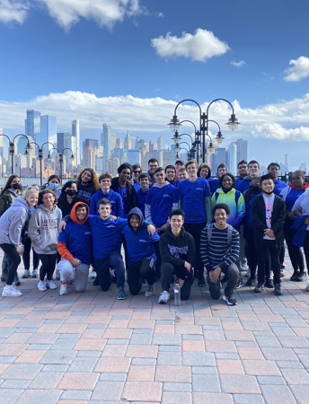

Special Programming & Student Leadership
SOS (Service on Saturday’s) Program
400 students, 13 programs, 25 leaders
Perfect leader attendance
Managing 20-40 volunteers at a time
Releasing the DOVEs – Mission Trips
Returnees in leadership roles
Leading reflections
Leading by example

